Slide 1
MedXplore
( PROTOTYPE FOR B.TECH MINOR PROJECT )
Department of Information Technology,
Bhagwan Parshuram Institute of Technology, Delhi

Slide 2
TEAM MEMBERS :
Akshita Aggarwal (00220803115)
Kunark Khewal (01520803115)
Rohit Meghwal (02720803115)
IT (7th Sem)

Slide 3
MENTOR :
Mr. C.M. Sharma Assistant Professor, Department of Information Technology, BPIT, Delhi

Slide 4
WHAT IS MEDXPLORE ?

Slide 5
MedXplore is a Web-Application.
It aims to assist in buying prescribed medicines in your local area.
It Lists the stores with a particular medicine available.
The Web-App offers features like-
User Registration & Login
Personal Dashboard
Search Medicine
MedBook (A Medicine Handbook)

Slide 6
There is a separate interface for Admin.
Admin can do the following tasks-
Update Medicines
Update Stores
Add Admin

Slide 7
WHY MEDXPLORE ?

Slide 8
Every Medical Practitioner has his/her own ‘set’ of drugs to prescribe.
This ‘set’ of drugs is only available in the pharmacies near the medical practitioner.
At times, it causes a great problem to the patient in case the drug runs out of stock.

Slide 9
Our app aims to help such patients find their prescribed drug in their local area.
The main purpose is to help patients get back to the best of their health instead of them getting stressed to find it.

Slide 10
HOW IS MEDXPLORE DEVELOPED ?

Slide 11
It is developed using the concepts of some widely-used present-day technologies like-
Java EE
Apache Tomcat Server
PostgreSQL Database
HTML5/CSS3
Bootstrap 4
JavaScript & JQuery

Slide 12
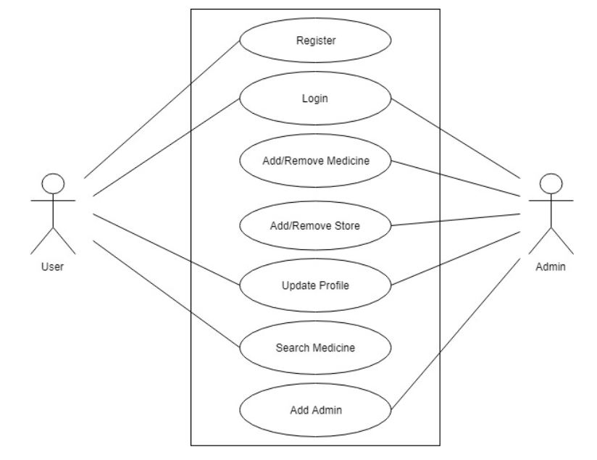
USE-CASE DIAGRAM

Slide 13
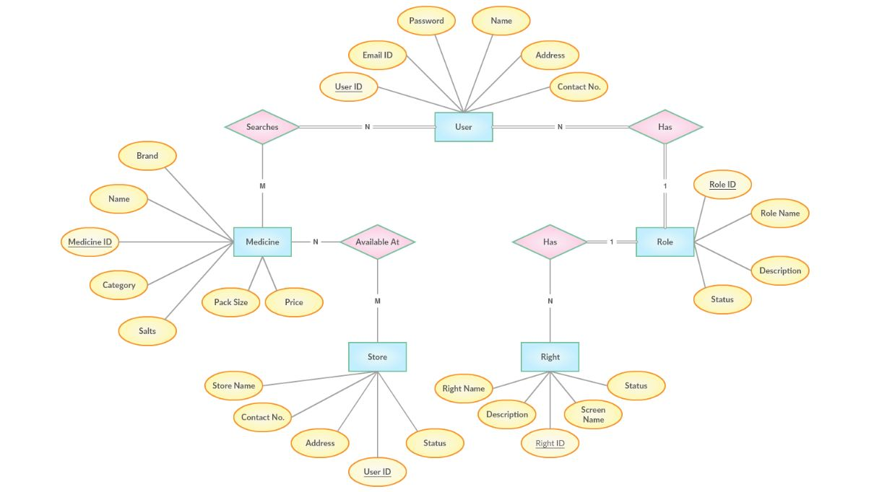
E-R DIAGRAM

Slide 14
Thank You!

